Slide 1


Tutorial: Assessing brain-cognition relationships in clinical populations using Canonical Correlation Analysis (CCA)
Beth Little bethany.little@ncl.ac.uk
Computational Neurology, Neuroscience & Psychiatry (CNNP) Lab
Newcastle University, UK
www.cnnp-lab.com

Slide 2
Overview
Background and motivation
Canonical Correlation Analysis (CCA) overview
Strengths and limitations of CCA
R code run through
Conclusion
https://github.com/BALittle/CCA_tutorial

Slide 3

Learning objectives
Understand the importance of multivariate methods for assessing brain-cognition relationships
Understand the fundamental principles of CCA and its strengths and limitations
Practical application of CCA in R using publicly available data
Interpretation of brain-cognition associations using CCA results
Prerequisites
R studio installed on laptop
R skills would be useful (but not required)
Knowledge of basic statistics (e.g., correlation/regression)
Knowledge of Principal Components Analysis would be useful (but not required)
https://github.com/BALittle/CCA_tutorial

Slide 4

Background and motivation
Patients can experience cognitive dysfunction in processes such as memory, language, attention and processing speed.
Understanding the relationship between brain structure (and function) and cognitive functions may:
Help informing surgery
Aid predictions of cognitive outcomes
Inform the development of targetted interventions
Aid our understanding of the disorder
https://github.com/BALittle/CCA_tutorial

Slide 5
Background and motivation
Previous research has linked cognitive dysfunction in epilepsy to brain structure such as cortical thickness and volume (Skirrow et al., 2011, 2015)
However, results are heterogeneous
Not all patients show the same, if any, cognitive impairments
No clear consensus on which cognitive impairments are related to which brain regions
The relationship between surgery and cognitive outcome is also complex:
Surgery can lead to cognitive improvement or impairment depending on baseline cognitive functioning, type of epilepsy, area of resection, and other clinical and demographic factors (Baxendale 2006, 2008, 2012).
Mixed results in the literature may be driven by:
Small sample sizes
Statistical approach of comparing group means
Univariate analysis – does not account for interactions between cognitive functions and has problem of multiple comparisons
https://github.com/BALittle/CCA_tutorial
Notes:
All this means that better understanding the relationship between brain structure and cognitive function generally, and in the presence of pathology such as epilepsy, is vital in

Slide 6
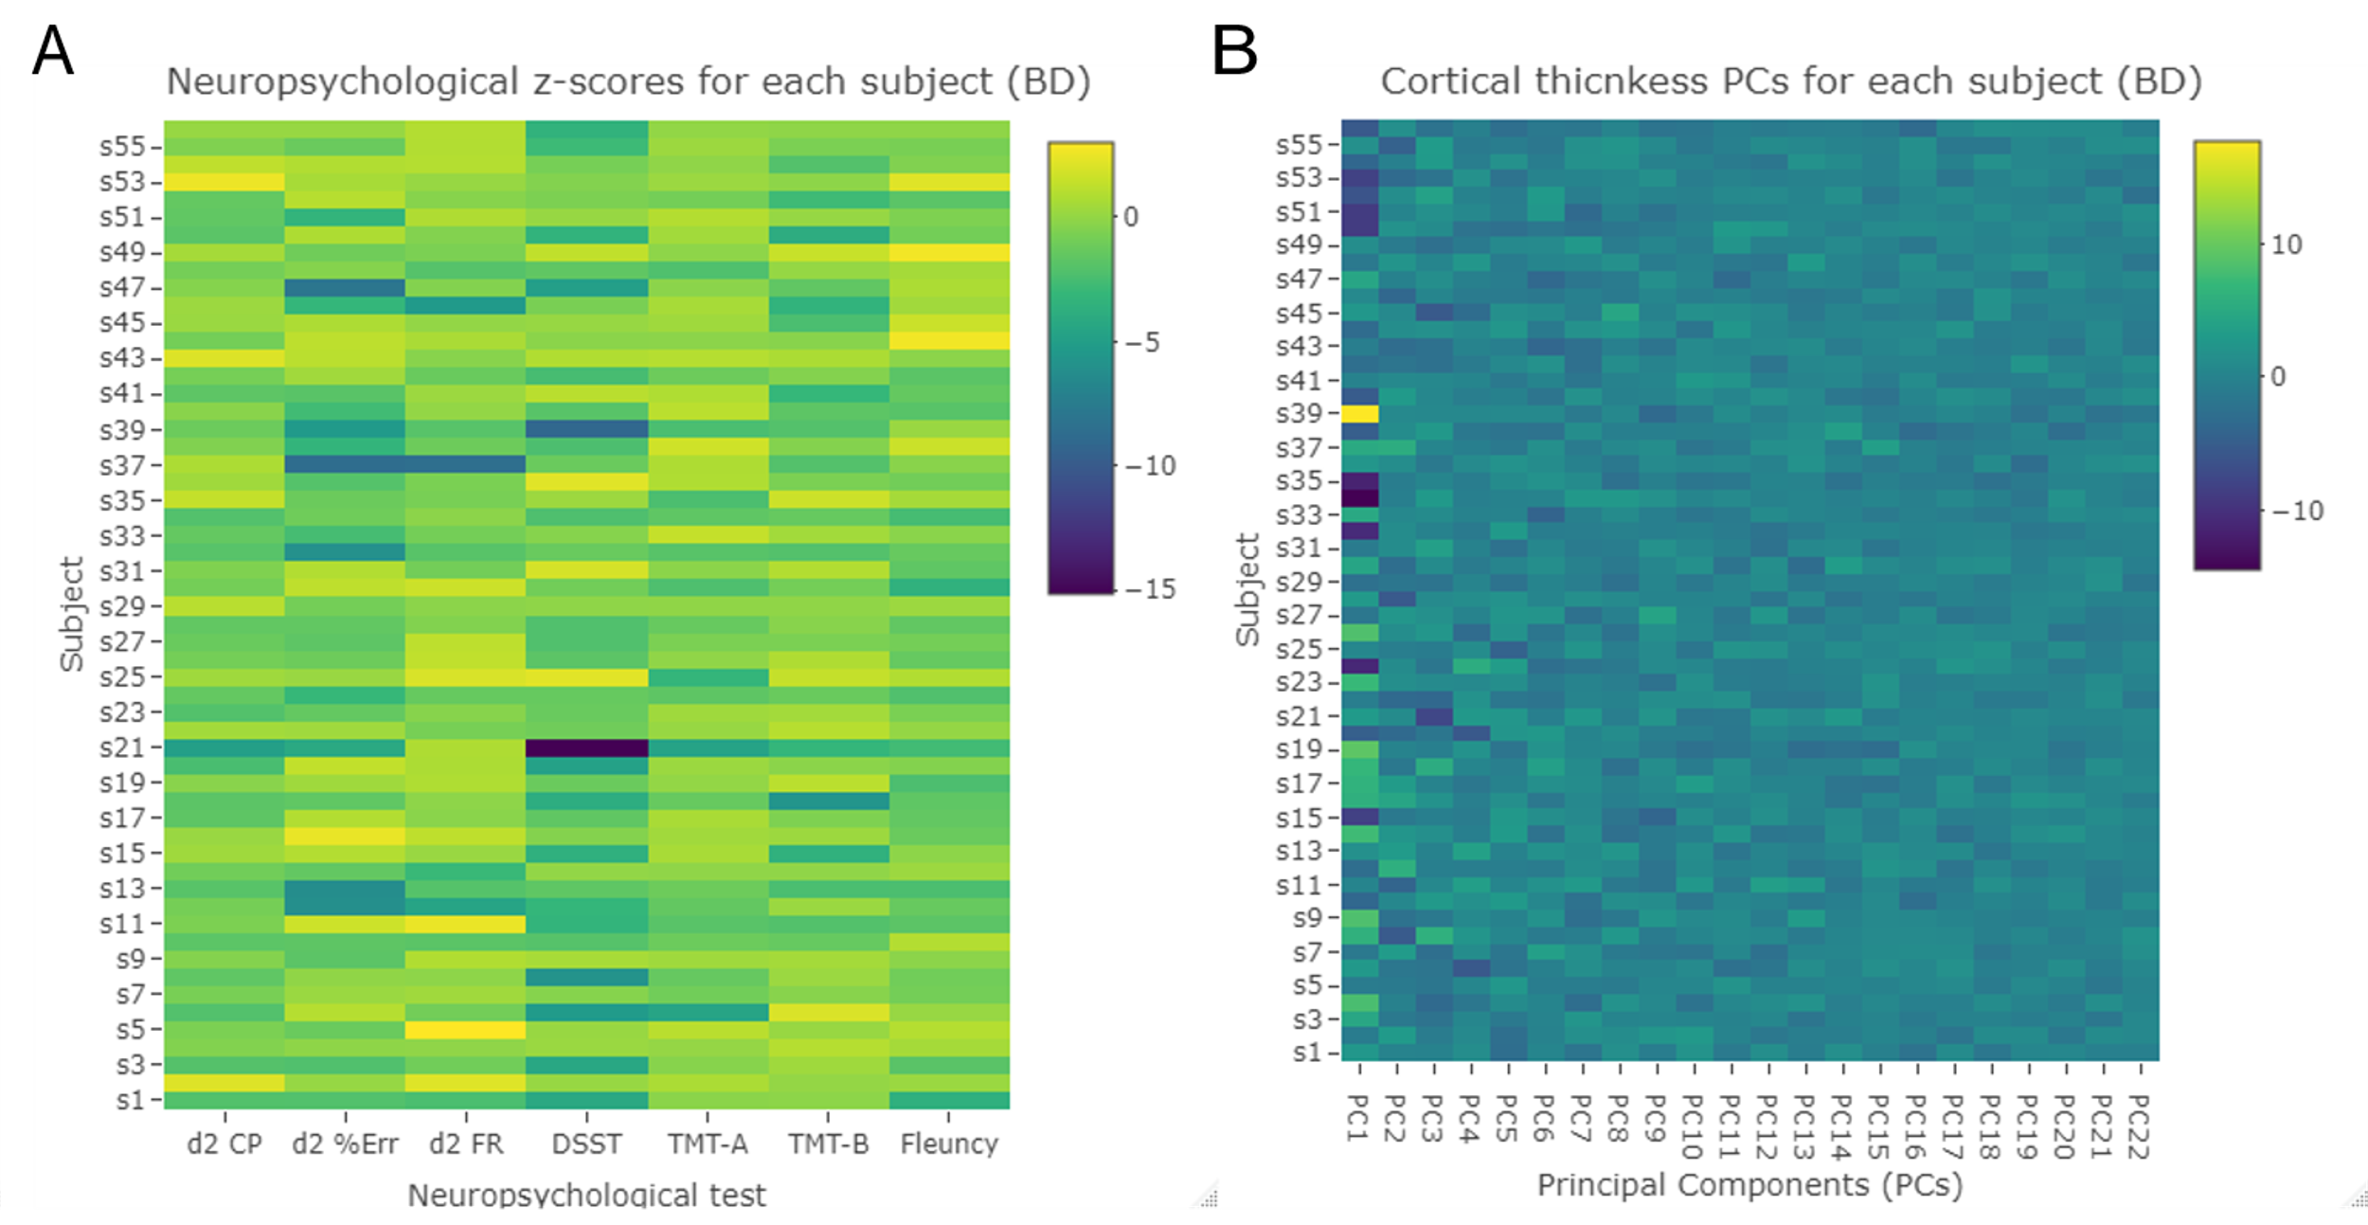
Multivariate analysis
Canonical Correlation Analysis (CCA)
CCA is a multivariate method to estimate the association between two set of variables.
https://github.com/BALittle/CCA_tutorial

Slide 7
CCA example
Little et al. 2023 (manuscript submitted to Bipolar Disorders)
Aim: explore associations between neuropsychological dysfunction and cortical thickness abnormalities in people with bipolar disorder using multivariate methods (CCA).
​ | Bipolar Disorder​ | Healthy Controls​
N​ | 56​ | 26​
Age (mean years [SD])​ | 45.36 [12.15]​ | 48.46 [11.80]​
Sex (N female [%])​ | 35 [62%]​ | 12 [46%]​
Education (mean [SD])​ | 14.14 [2.88]​ | 16.46 [3.78]​
Neuropsychological data (7 cognitive variables)
T1-weighted MRI scans (cortical thickness for n=68 regions)
https://github.com/BALittle/CCA_tutorial

Slide 8
CCA example
Cognitive tests/variables
d2 test of attention
Concentration Performance
Percentage of Errors
Fluctuation Rate
Digit Symbol Substitution Test
Symbol time minus copy time
Trail-Making Test
Part A (time)
Part B (time minus part A time)
Category fluency
total score
Cognitive tests/variables
Cortical thickness for 68 regions
CCA is a multivariate method to estimate the association between two set of variables.
https://github.com/BALittle/CCA_tutorial

Slide 9
CCA example
T1-w MRI data (cortical thickness)
Pre-processed using standard recon-all pipeline in Freesurfer
Manual edits of pial surface
Extracted cortical thickness for each region (Desikan-Killiany atlas)
Neuropsych data
Exclude subjects with MR artefacts and too much missing cognitive data
Exclude subjects with MR artefacts and too much missing cognitive data
Winsorized extreme outliers (HC)
Log transform data
Impute missing data (regression)
Box-Cox transform ROIs in HCs (apply transforms to BD group)
Regress out age and pmIQ
Regress out age and sex
Z-score based on control mean and SD
Z-score based on control mean and SD
https://github.com/BALittle/CCA_tutorial

Slide 10
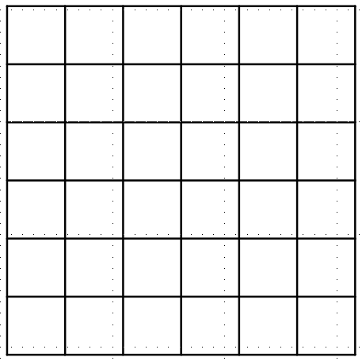
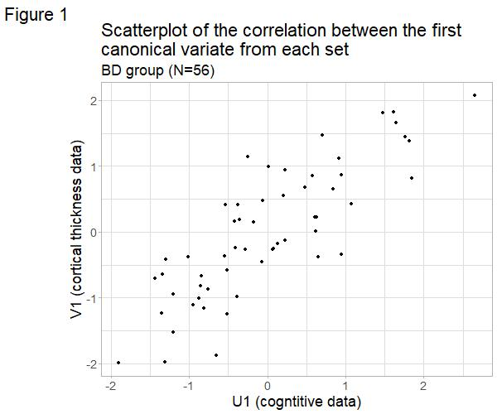
CCA example
Canonical loadings
Canonical cross-loadings
Canonical variates
Principal Components Analysis
Predictors U
Predictors V
cognitive dataset
(neuropsych scores)
MRI dataset (cortical thickness)
U1
V1
First canonical correlation
Participants
Participants
Cognitive scores
ROIs
https://github.com/BALittle/CCA_tutorial

Slide 11
CCA example
Ran CCA on bipolar group only.
Tested canonical correlations using:
Test of significance (Pillai’s trace)
Permutation test
Dataset was randomly shuffled (mismatch subject indices between matrices), then CCA performed on this random dataset.
10,000 permutations were run → null distribution of canonical correlations.
Produces a p-value which you can compare to the original p-value.
https://github.com/BALittle/CCA_tutorial

Slide 12
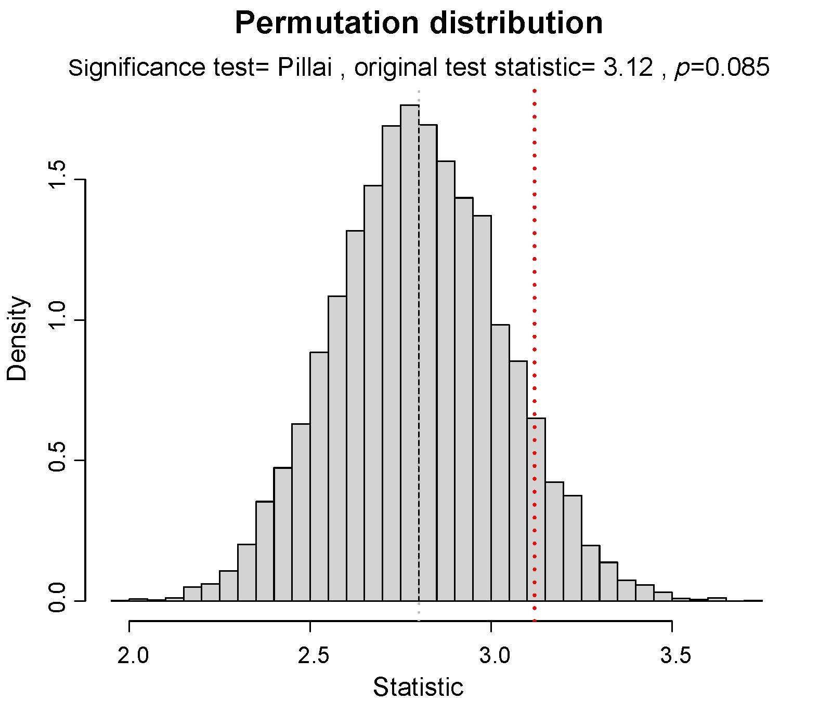
CCA example – results (CCA)
First canonical correlation (N=56)
Canonical correlation | Correlation coefficient | Significance test (Pillai’s trace p)
1 | .832 | .043
Permutation test p=.085
https://github.com/BALittle/CCA_tutorial

Slide 13
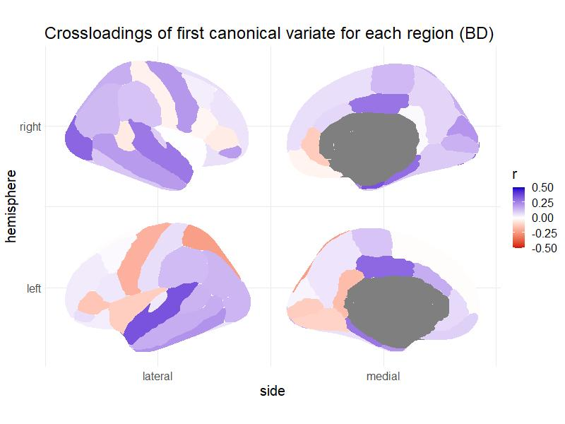
CCA example – results (CCA)
Cross-loadings
Cognitive variables | Cross-loadings
d2 Continuous Performance | -.049
d2 Percentage of Errors | -.189
d2 Fluctuation Rate | -.322*
DSST | -.306*
TMT-A | .249
TMT-B | .374*
Category Fluency | -.136
Canonical correlation | Correlation coefficient | Significance test (Pillai’s trace p)
1 | .832 | .043
Cortical thickness Region | Left hemisphere | Right hemisphere
Entorhinal | .224 | .360*
Lateral occipital | .150 | .316*
Parahippocampal | .283 | .302*
Posterior cingulate | .312* | .287
Superior temporal | .359* | .279
https://github.com/BALittle/CCA_tutorial
Notes:
Cross loadings threshold of above .3 or below -.3

Slide 14
CCA example – results summary
In BD patients, tests of attention (d2 fluctuation rate), processing speed (DSST) and executive function (TMT-B) were associated with cortical thickness in the following areas:
Left posterior cingulate cortex (PCC) and superior temporal areas, and right parahippocampal, entorhinal and lateral occipital areas.
Some areas have a role in the Default Mode Network
BUT
Other measures of processing speed (TMT-A), attention (d2), and executive function (fluency), were not associated with the first canonical correlation.
Canonical correlation not significant after permutation test (p=.08).
https://github.com/BALittle/CCA_tutorial

Slide 15
CCA example
https://github.com/BALittle/CCA_tutorial

Slide 16
Data pre-processing
Missing data – delete cases, impute missing data
Check data meet assumptions of statistical tests
Outliers, distribution (of residuals)
Choose appropriate tests, Winsorize and/or transform data if necessary
Regress out confounding variables
Control for age, sex, ICV and scan site
Z-score data (based on HC mean and SD?)
Data cleaning
Missing data – delete cases, impute missing data
Check data fit assumptions of statistical tests
Outliers, distribution (of residuals)
Choose appropriate tests, Winsorize and/or transform data if necessary
Regress out confounding variables
Control for age, sex, ICV and scan site
Z-score data (based on HC mean and SD?)
Group differences
Parametric or non-parametric tests
CCA
Run PCA (?) (on behavioural/structural MRI data separately)
CCA
interpret canonical correlations
Interpret loadings and cross-loadings
Permutation test
https://github.com/BALittle/CCA_tutorial

Slide 17
Code tutorial
R script: CCA_tutorial.r
Available at https://github.com/BALittle/CCA_tutorial
This example uses public data: the National Institute of Mental Health (NIMH) Intramural Healthy Volunteer Dataset
Available at https://openneuro.org/datasets/ds004215/versions/1.0.2
https://github.com/BALittle/CCA_tutorial

Slide 18
Dataset
Cortical thickness of 68 regions
The NIH Toolbox Cognition Battery
A flanker inhibitory control task (attention and executive function)
A dimensional change card sort test (executive function)
Picture sequence memory test (episodic memory)
A list sorting test (working memory)
Picture vocabulary test (language)
Oral reading recognition test (language)
Pattern comparison test (processing speed)
DISCLAIMER – using data 'as is' (not checked)
Notes:
For the cognitive tests:
A flanker inhibitory control task (attention and executive function) - age corrected standard score
A dimensional change card sort test (executive function) - age corrected standard score
Picture sequence memory test (episodic memory) - age corrected standard score
A list sorting test (working memory) - age corrected standard score
Picture vocabulary test (language) -
Oral reading recognition test (language) -
Pattern comparison test (processing speed) -

Slide 19
References
Baxendale, S. et al. (2006) Predicting memory decline following epilepsy surgery: A multivariate approach, Epilepsia, 47(11), 1887–1894.
Baxendale, S., Thompson, P.J. and Duncan, J.S. (2008) Improvements in memory function following anterior temporal lobe resection for epilepsy, Neurology, 71(17), 1319–1325.
Baxendale, S., Thompson, P.J. and Duncan, J.S. (2012) Neuropsychological function in patients who have had epilepsy surgery: A long-term follow-up, Epilepsy and Behavior, 23(1), 24–29.
Baxendale, S., Thompson, P.J. and Sander, J.W. (2013) Neuropsychological outcomes in epilepsy surgery patients with unilateral hippocampal sclerosis and good preoperative memory function, Epilepsia, 54(9), 131–134.
Skirrow, C. et al. (2011) Long-term intellectual outcome after temporal lobe surgery in childhood, Neurology, 76(15), 1330–1337
Skirrow, C. et al. (2015) Temporal lobe surgery in childhood and neuroanatomical predictors of long-term declarative memory outcome, Brain, 138(1), 80–93.
https://github.com/BALittle/CCA_tutorial

